Slide 1


MINISTRY/ORGANIZATION NAME : AICTE PS CODE : 1493 TEAM NAME : HACK WIZARDS PROBLEM STATEMENT TITLE : STUDENT INNOVATION
TEAM LEADER NAME : MUSKAN YADAV THEME NAME : MISCELLANEOUS INSTITUTE CODE (AISHE) : C-46141 INSTITUTE NAME : ABES INSTITUTE OF TECHNOLOGY
Problem Statement:
Ideas that showcase the rich cultural heritage and traditions of India
INSTANCE OF APPROACH
Use
Chart
Start
*Cultural Heritage Walks Museum Exhibitions
*Festivals and Cultural Events
*Documentary Films and Television Series
*Cultural Workshops
*Cuisine Experiences
*Cultural Exchanges
*Online Platforms:
*Heritage Conservation
*Cultural Education
*Cultural Tours
*Art Galleries
Home
Assistant
Bookings
Explore
Visitor Stats
Vehicles
Select state
Events
Select category
Ind. Artistry
Get content
Voice/Video Description
Picture
3D view

Slide 2






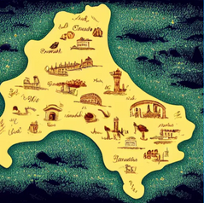
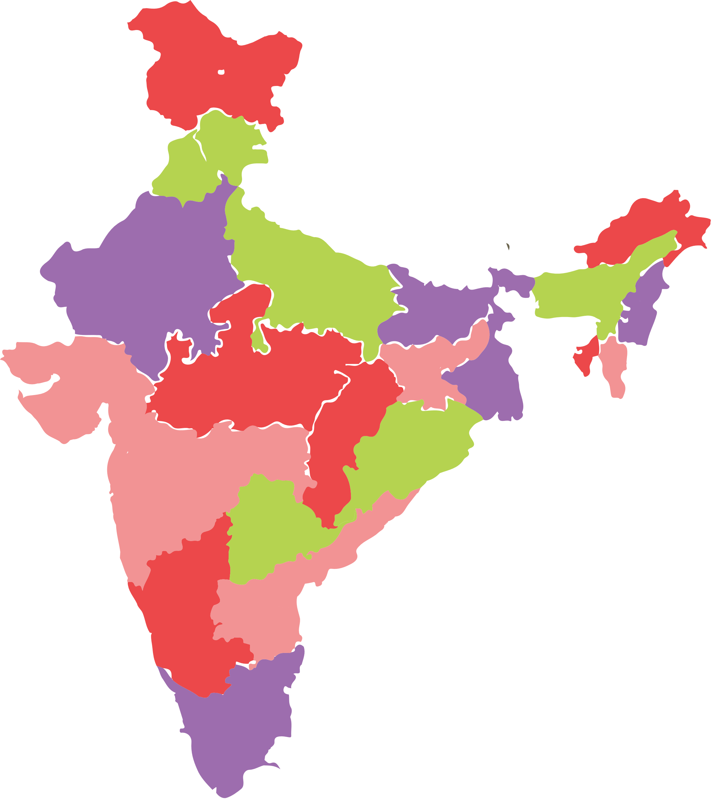













IMPORTANT POINTS
Work Flow
*Generating revenue to the governments.
◆
*A chatbot
◆ *Multilingual support
*Audio descriptions
*Heritage Tourism
user
state
catagory
Halting
proto:-
https://www.figma.com/file/XjhiT6p2MLPlalIg5yLuTc/Untitled?type=design&node-id=0%3A1&mode=design&t=r9f00PDLSKwnCqdt-1
TECH
STACK

Slide 3





TEAM
HACK WIZARDS
>TEAM LEADER NAME: MUSKAN YADAV BRANCH : BTECH STREAM : CSDS YEAR : II >TEAM MEMBER 1 NAME: NAYAN MISHRA BRANCH : BTECH STREAM: CSAI YEAR : II >TEAM MEMBER 2 NAME: SUMIT SHARMA BRANCH : BTECH STREAM : CSIOT YEAR : >TEAM MEMBER 3 NAME: MANSI SHARMA BRANCH : BTECH STREAM : CSDS YEAR : II >TEAM MEMBER 4 NAME: RAJAT GUPTA BRANCH : BTECH STREAM : CSAI YEAR : II >TEAM MEMBER 5 NAME: MANSI ALUNA BRANCH : BTECH STREAM : CSDS YEAR : II >TEAM MENTOR 1 NAME: MR. KAMAL KHASHYAP

